Slide 1


KGiSL INSTITUTE OF TECHNOLOGY
COIMBATORE
DEPARTMENT OF ELECTRONICS & COMMUNICATION ENGINEERING
AU PROJECT VIVA VOCE
“ Design Of 8 bit identity comparator using Xilinx software ”
TEAM MEMBERS:
711721106101 SHRIMUGI.S 711721106080 RAJESH .G 711721106107 SNEHA.S 711721106095 SARVESHWARAN.P
Under the guidance of :
Dr.S.K. MYDHILI , Professor, Department of ECE

Slide 2
Agenda
Introduction
Literature Survey
Objective of the project work
Existing Pin diagram
Proposed Pin diagram
Block diagram
Methodology – Proposed
Expected Outcome
Simulated Outputs
Overall observation
Advances/Merits of Proposed System
Challenges Faced
Conclusion
Future Enhancement
References

Slide 3
INTRODUCTION
Identity comparators are indispensable digital tools that verify exact matches between two entities, ensuring accuracy and reliability across diverse domains.
In data validation scenarios, they authenticate user credentials in systems like website logins. Signal processing applications leverage identity comparators to discern matching commands in electronic devices such as remote controls.
Quality control processes in manufacturing rely on them to validate product specifications, ensuring each item meets set standards.
Additionally, identity comparators bolster security protocols by confirming the legitimacy of presented credentials in access control systems.
Their role in guaranteeing precision, consistency, and security underscores their vital significance in modern technological ecosystems.

Slide 4
LITERATURE SURVEY
TITLE “ | PUBLICATION DETAILS | METHODOLOGY/ ALGORITHMS | MERITS | DEMERITS
Design of a High-Performance 2-bit Comparator Using Hybrid Logic Style | Md. Ashik Zafar Dipto, Afran Sorwar, title under “Design of a High-Performance 2-bit Comparator Using Hybrid Logic Style” INSPEC Accession Number: 20063973 DOI: 10.1109/ICCCNT49239.2020.9225524 Publisher: IEEE Conference Location: Kharagpur, India Published in: 2020 11th International Conference on Computing, Communication and Networking Technologies (ICCCNT) | Design of a 2-bit binary Comparator (MC) design is simulated along with 5 other existing MC designs in order to carry out evaluation and comparison. significant enhancement in Power Delay Product (PDP) could have been attained. Due to the significant enhancement in performance, the proposed MC can be considered as a highly effective alternative to the existing MC designs. | increased speed and power Power delay product is obtained | Complex design

Slide 5
LITERATURE SURVEY
TITLE | PUBLICATION DETAILS | METHODOLOGY /ALGORITHMS | MERITS | DEMERITS
Low Power Design of a Two Bit Comparator for High Speed Operation | Mehedi hasan, Uttam Kumar Saha, Muhammad Saddam Hossain, Parag Biswas under the topic of “Low Power Design of a Two Bit Comparator for High Speed Operation” INSPEC Accession Number: 18971727 DOI: 10.1109/ICCCI.2019.8822197 Publisher: IEEE Conference Location: Coimbatore, India Published in: 2019 International Conference on Computer Communication and Informatics (ICCCI) | 1) new two-bit binary comparator consisting 46 transistors. 2) design has been conducted using Cadence Computer Aided Design apparatus in 90 nm Technology. 3)compared with the existing two-bit binary comparator design. TOOL: cadence(Computer Aided Design apparatus in 90 nm Technology) | increased speed and power Power delay product is obtained | → could not obtain data on the performance aspects for comparison → Logic swing of this design was poor which resulted in highest propagation delay (0.495 ns).
5

Slide 6
LITERATURE SURVEY
TITLE | PUBLICATION DETAILS | METHODOLOGY /ALGORITHMS | MERITS | DEMERITS
Design Method for Online Totally Self-Checking Comparators Implementable on FPGAs | Yusuke Kanno , Member, IEEE, Tadanobu Toba, Kotaro Shimamura, Member, IEEE, and Nobuyasu Kanekawa, Senior Member, IEEE Design Method for Online Totally Self-Checking Comparators Implementable on FPGAs with the Center for Technology Innovation— Electronics, Hitachi, Ltd., DOI:10.1109/TVLSI.2019.294680 Date : February 25, 2020 | →field-programmable gate array (FPGA), neutron radiation, →single-event upset (SEU), softerror rate (SER), totally self-checking (TSC). →funneling mechanism →data-logging method TOOL : Xilinx’s Virtex 7 FPGA (XC7VX485T-2FFG1761, VC707 Evaluation Kit) | →require high dependability. →maintains 100% of coverage →available faster to the market. →design flow eliminates complex and time consuming place and router | →it looses the program stored in the memory when the power is made off →quantity of FPGAs to be manufactured increases, cost per product also increases.

Slide 7
LITERATURE SURVEY
TITLE | PUBLICATION DETAILS | METHODOLOGY /ALGORITHMS | MERITS | DEMERITS
AN OPTIMIZED DESIG OF 64-BIT COMPARATOR BY USING REVERSIBLE LOGIC | SHAIK SALEHA, Dr.S. KOTESWARA RAO AN OPTIMIZED DESIG OF 64-BIT COMPARATOR BY USING REVERSIBLE LOGIC ISSN 2581 – 4575 Date : 02, Feb 2021 Publisher : IEEE | →Feynman gate →3X3 reversible gate, PERES gate →3*3 Toffoli gate →3*3 Fredkin Gate →RTL coding is done using Verilog →implementation in Xilinx 80nm technology →TOOL : Xilinx ISE tool →Language used : Verilog HDL | →reduce power dissipation →low power digital design | → optimization number of constant inputs, garbage outputs, and quantum cost
7

Slide 8
LITERATURE SURVEY
TITLE | PUBLICATION DETAILS | METHODOLOGY /ALGORITHMS | MERITS | DEMERITS
Design and Simulation of a Low Design and Simulation of a Low Power and High-Speed 4-Bit Comparator Circuit using CMOS in DSch and Microwind | Muhibul Haque Bhuyan, Md. Mubarak Hossain Riyadh, Md. Sazzad Hossain , Md. Anisur Rahman, “Design and Simulation of a Low Design and Simulation of a Low Power and High-Speed 4-Bit Comparator Circuit using CMOS in DSch and Microwind” Department of Electrical and Electronic Engineering Southeast University, Tejgaon I/A, Dhaka 1208, Bangladesh Bangladesh Electronics. 20 (1-2); 82-94, 2020 | i.study VLSI circuit design using DSch and Microwind ii. design a logic circuit for a 4-bit comparator circuit iii. develop a simulation model for the 4-bit comparator circuit at various nodes iv. generate the layout diagram for a 4-bit comparator circuit v. analyze the VLSI circuit performance at various nodes from 90 nm to 45 nm TOOL : DSch and microwind | Low power consumption High speed | Varies in size Propagation delay increases
8

Slide 9
LITERATURE SURVEY
TITLE | PUBLICATION DETAILS | METHODOLOGY /ALGORITHMS | MERITS | DEMERITS
Design of High Speed 8-Bit Comparator for Security Application | S.Munratiwar,Y.Saikrisha and V. Jyothi, "Design of High Speed 8-Bit Comparator for Security Application," 2022 IEEE International Conference on Distributed Computing and Electrical Circuits and Electronics (ICDCECE), Ballari, India, 2022, pp. 1-6, doi: 10.1109/ICDCECE53908.2022.9793032. | Comparison of voltage and current. Conventional Comparators are used for Comparison .XNOR Gates are used to build 4-Bit Comparators. TOOL: Xilinix—Verilog. | Accuracy Real time processing Versatility | Complexity Sensitivity to noise
9

Slide 10
LITERATURE SURVEY
TITLE | PUBLICATION DETAILS | METHODOLOGY /ALGORITHMS | MERITS | DEMERITS
Two-Bit Comparator Design Using Gate Diffusion Input Technique and Static CMOS Logic | U. B. Joy, A. Chakraborty, P. Biswas, A. Das, S. Sen and A. Tasnim, "Two-Bit Comparator Design Using Gate Diffusion Input Technique and Static CMOS Logic," 2023 3rd International Conference on Robotics, Electrical and Signal Processing Techniques (ICREST), Dhaka, Bangladesh, 2023, pp. 17-21, doi: 10.1109/ICREST57604.2023.10070047. | Operation of Arithmetic Logic Unit(ALU) of modern processors. Gate Diffusion Input (GDI) technique Static CMOS (S-CMOS) logic TOOL : Cadence Virtuoso(90 nm technology with a supply voltage of 1.0 V ) | Minimize transistor count Compact circuit design, Provides high noise immunity Scalable | Complex to design High power optimization Variability and Sensitivity Limited Resoltion
10

Slide 11
LITERATURE SURVEY
TITLE | PUBLICATION DETAILS | METHODOLOGY /ALGORITHMS | MERITS | DEMERITS
An Approach form Synthesis of magnitude comparaators. | N. Borodzhieva and I. D. Tsvetkova, "An Approach for Synthesis of Magnitude Comparators," 2021 XXX International Scientific Conference Electronics (ET), Sozopol, Bulgaria, 2021, pp. 1-4, doi: Publisher: IEEE 10.1109/ET52713.2021.9579664. | Thepaper presents an approach for the synthesis of magnitude comparator comparing two five-bit binary numbers.. The work is related to the project in the course “Pulse and Digital Devices” for students-bachelors of the specialties “Electronics” and “Internet and Mobile Communications”. Software :Xilinx | High resolution | Complex design
11

Slide 12
OBJECTIVE
To design the identity comparator which is a crucial component in digital circuit design, tasked with comparing two input values and determining if they are equal
VHDL (VHSIC Hardware Description Language) is utilized to describe the behavior and structure of the identity comparator.
The design is implemented on the Xilinx platform, specifically targeting Xilinx FPGAs (Field-Programmable Gate Arrays) such as the Xilinx As 5 series.

Slide 13
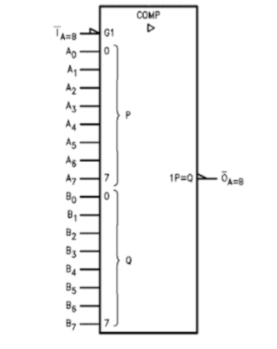
EXISTING -PIN DIAGRAM:

Slide 14
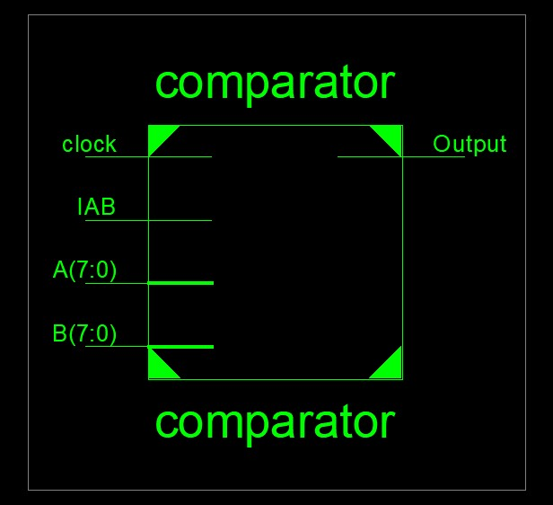
PROPOSED-PIN DIAGRAM:

Slide 15
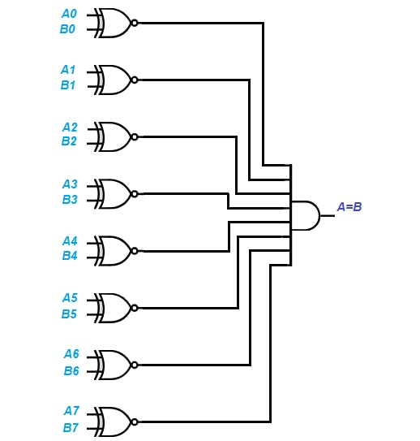
BLOCK DIAGRAM:

Slide 16
Proposed methodolgy:
XILINX SOFTWARE
VHDL-BEHAVIOURAL CODE
VIEW THE RTL SCHEMATIC VIEW
VERIFY THE OUTPUT WITH TRUTH TABLE
VIEW THE SIMULATED OUTPUT
VIEW THE TECHNOLOGICAL SCHEMATIC VIEW

Slide 17
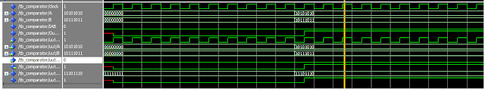
Expected outcome

Slide 18
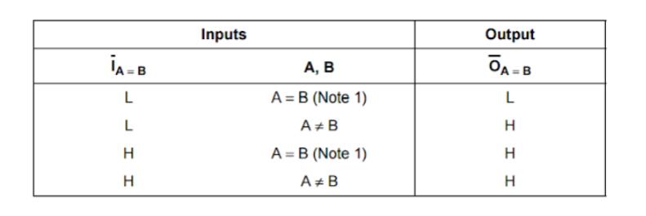
Expected outcome

Slide 19
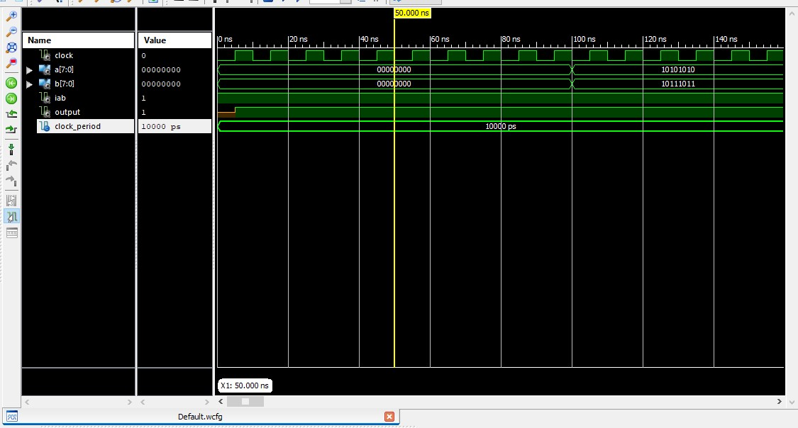
Simulated outcome

Slide 20
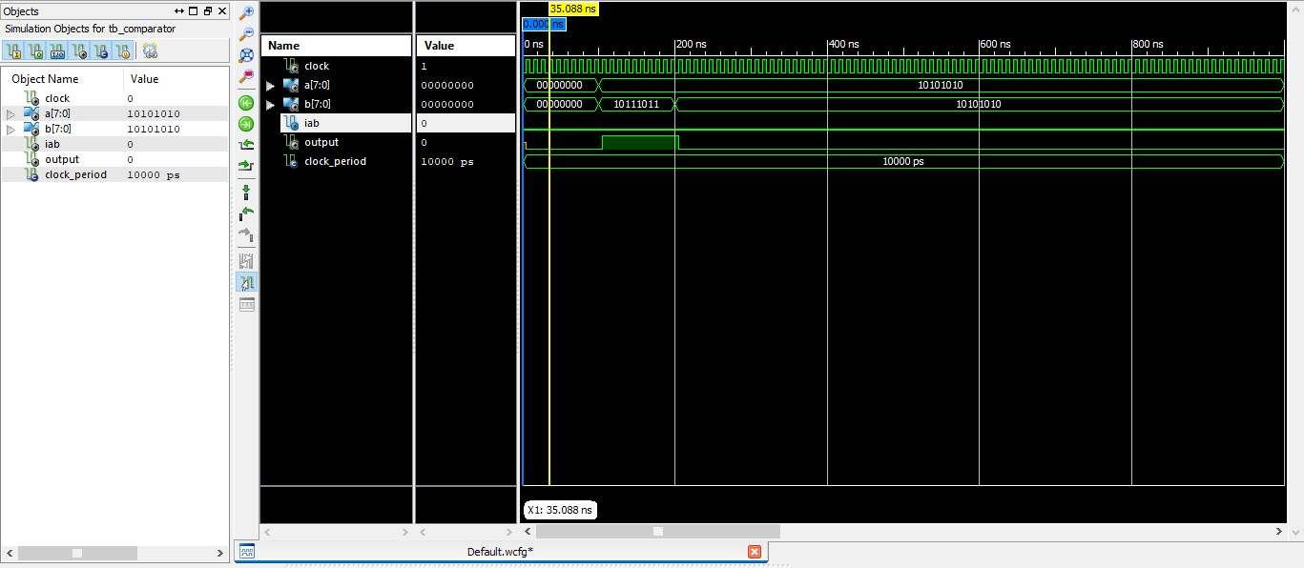

Slide 21
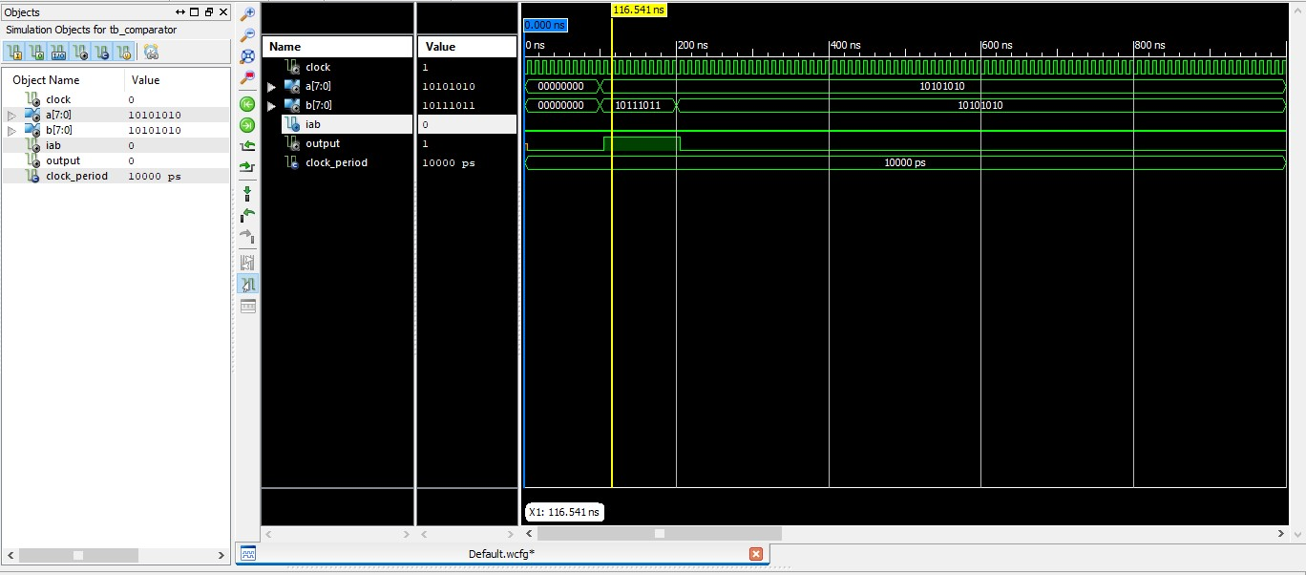

Slide 22
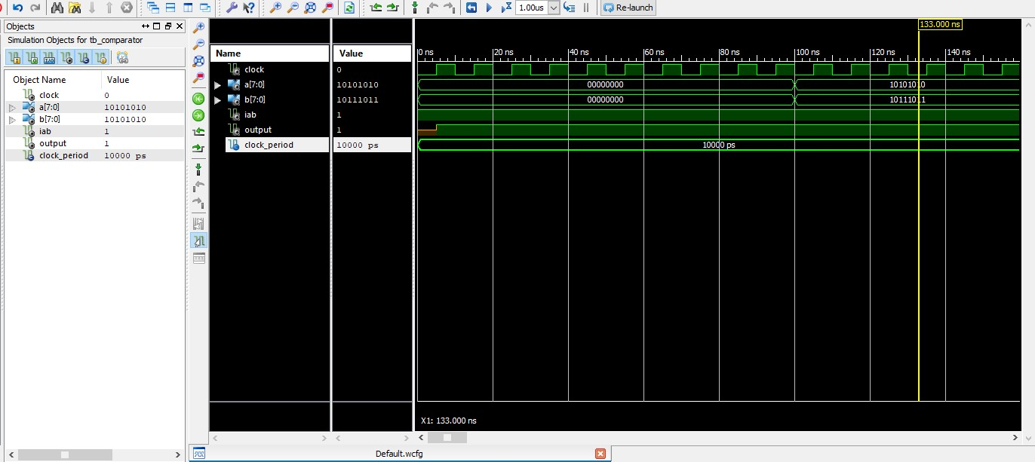

Slide 23
OVERALL OBSERVATION
S.NO | A[7:0] | B[7:0] | IA:B | OUTPUT
1 | 00000000 | 00000000 | 0 | 1
2 | 00000000 | 00000000 | 1 | 0
3 | 10101010 | 10111011 | 0 | 1
4 | 10101010 | 10111011 | 1 | 1

Slide 24
ADVANCES/ MERITS OF PROPOSED WORK
Identity comparators ensure data integrity, detect faults promptly, aid in decision-making processes, enhance security measures, facilitate efficient signal processing, and automate tasks, improving operational efficiency in dynamic and time-sensitive environments.
Utilizing VHDL for the identity comparator design offers several advantages, including modularity, reusability, and ease of integration into larger digital systems.

Slide 25
CHALLENGES FACED
Managing complexity involves structuring VHDL code for readability and maintainability, crucial for large data widths and intricate logic.
Meeting timing constraints and speed requirements demands careful optimization, considering propagation delays and resource allocation.
Thorough simulation and testing are imperative for functionality validation and reliability assurance, necessitating comprehensive testbenches and debugging expertise.

Slide 26
CONCLUSION
In conclusion, designing an identity comparator in Xilinx software using VHDL code is a complex yet essential task. Despite the challenges faced in managing complexity, meeting timing constraints, optimizing resource utilization, and ensuring reliability through thorough testing, the benefits are immense.
This digital detective, adept at comparing data streams in real-time applications, offers enhanced data integrity, fault detection, decision-making capabilities, security enforcement, signal processing efficiency, and automation.
With careful design and testing, the identity comparator becomes a reliable cornerstone in various digital systems, ensuring accuracy, consistency, and efficiency in everyday operations.

Slide 27
FUTURE ENHANCEMENT
In the future, identity comparators can be enhanced by making them faster through parallel processing, smarter with advanced algorithms and AI integration, and more efficient with hardware acceleration and low-power design.
These improvements aim to make identity comparators faster, smarter, and more secure, ensuring they can keep up with the growing demands of modern digital systems while consuming less power and providing greater protection against threats.

Slide 28
REFERENCE
[1] Md. Ashik Zafar Dipto, Afran Sorwar, title under “Design of a High-Performance 2-bit Comparator Using Hybrid Logic Style” INSPEC Accession Number: 20063973DOI: 10.1109/ICCCNT49239.2020.9225524Publisher: IEEE
[2] Mehedi hasan, Uttam Kumar Saha, Muhammad Saddam Hossain, Parag Biswas under the topic of “Low Power Design of a Two Bit Comparator for High Speed Operation”INSPEC Accession Number: 18971727DOI: 10.1109/ICCCI.2019.8822197
[3] Yusuke Kanno , Member, IEEE, Tadanobu Toba, Kotaro Shimamura, Member, IEEE,and Nobuyasu Kanekawa, Senior Member, IEEE Design Method for Online Totally Self-Checking Comparators Implementable on FPGAs with the Center for Technology Innovation—Electronics, Hitachi, Ltd.,DOI:10.1109/TVLSI.2019.294680
[4] SHAIK SALEHA,Dr.S. KOTESWARA RAO AN OPTIMIZED DESIG OF 64-BIT COMPARATOR BY USING REVERSIBLE LOGIC ISSN 2581 – 4575 Date : 02, Feb 2021 Publisher : IEEE

Slide 29
REFERENCE
[5] Muhibul Haque Bhuyan, Md. Mubarak Hossain Riyadh, Md. Sazzad Hossain, Md. Anisur Rahman, “Design and Simulation of a Low Design and Simulation of a Low Power and High-Speed 4-Bit Comparator Circuit using CMOS in DSch and Microwind” Southeast University, Tejgaon I/A, Dhaka 1208, Bangladesh Electronics. 20 (1-2); 82-94, 2020
[6] S.Munratiwar,Y.Saikrisha and V. Jyothi, "Design of High Speed 8-Bit Comparator for Security Application," 2022 IEEE International Conference on Distributed Computing and Electrical Circuits and Electronics (ICDCECE), Ballari, India, 2022, pp. 1-6, doi: 10.1109/ICDCECE53908.2022.9793032.
[7] U. B. Joy, A. Chakraborty, P. Biswas, A. Das, S. Sen and A. Tasnim, "Two-Bit Comparator Design Using Gate Diffusion Input Technique and Static CMOS Logic," 2023 3rd International Conference on Robotics, Electrical and Signal Processing Techniques (ICREST), Dhaka, Bangladesh, 2023, pp. 17-21, doi: 10.1109/ICREST57604.2023.10070047.

Slide 30
REFERENCE
[8] N. Borodzhieva and I. D. Tsvetkova, "An Approach for Synthesis of Magnitude Comparators," 2021 XXX International Scientific Conference Electronics (ET), Sozopol, Bulgaria, 2021, pp. 1-4, doi: 10.1109/ET52713.2021.9579664 Publisher: IEEE

Slide 31
THANK YOU

